Slide 1

Fetal Health Data Analysis
Coding Dojo Project 02
By Vino S Raj

Slide 2
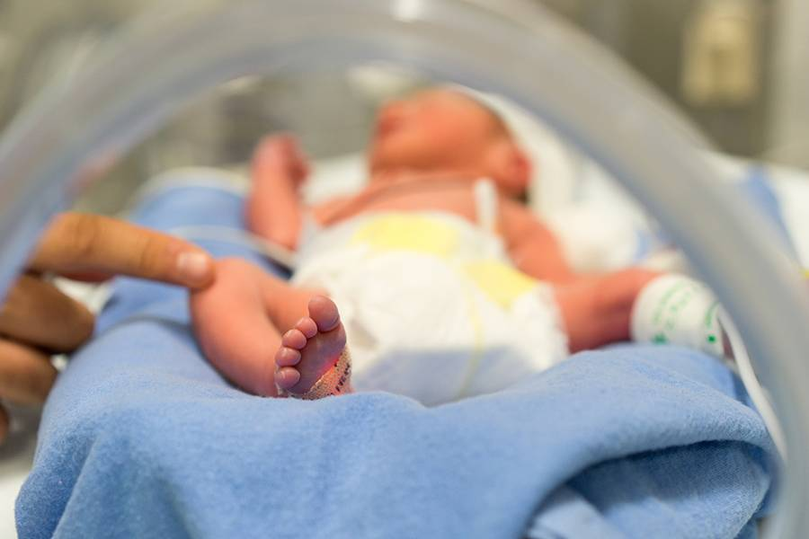
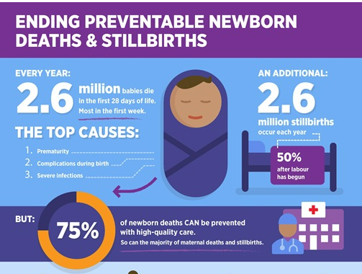
Context
Every year 2.6 Millions babies die with in the first 28 days of their life . Mostly in the first week.
In Parallel the course of Maternal mortality accounts for around 295000 deaths during or following pregnancy. (Due to fetal complications. )
Health complications during the gestation period have evolved as a global issue.
These complications sometimes result in the mortality of the fetus, which is more prevalent in developing and underdeveloped countries.
Key factor is that 75% of this can be prevented.
Child mortality is a UN Sustainable Development goal.
https://www.who.int/westernpacific/about/how-we-work/pacific-support/news/detail/23-10-2017-new-un-report-highlights-child-mortality-rates-for-the-pacific

Slide 3
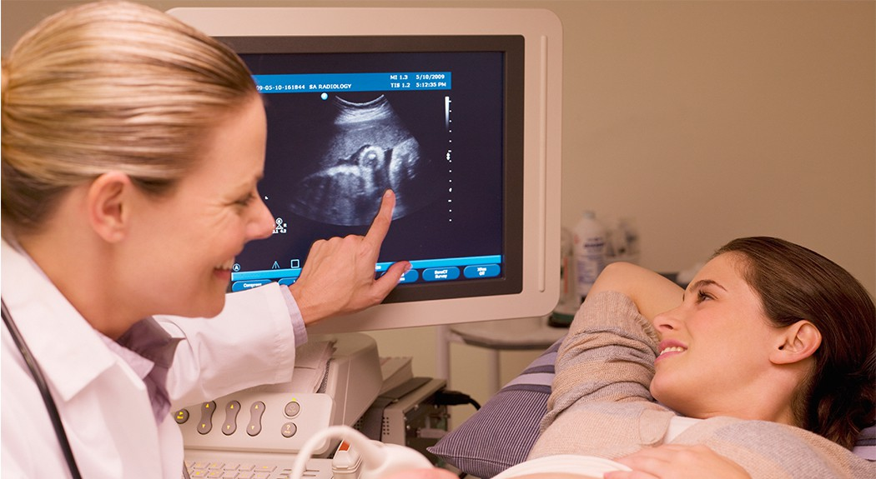
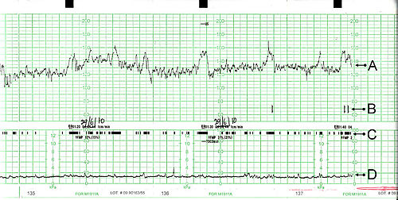
Project introduction
What is a CTG?
Cardiotocography (CTG) records changes in the fetal heart rate and their temporal relationship to uterine contractions. The aim is to identify the short of oxygen (hypoxic) to guide fetal wellbeing, or determine if additional therapeutic necessities.
CTG measure 5 key criterias - Baseline Fetal Heart rate, Variability, Acceleration. Deceleration and short term variation
An expert obstetrician can use these measurements to label a fetus status to a normal , suspected or pathologic.
Can we use machine learning to predict these labeling?
https://onlinelibrary.wiley.com/doi/10.1111/exsy.12899

Slide 4
The Data
Source :
Ayres de Campos et al. (2000) SisPorto 2.0 A Program for Automated Analysis of Cardiotocograms. J Matern
Fetal Med 5:311-318
https://www.kaggle.com/datasets/andrewmvd/fetal-health-classification
Data :
This dataset contains 2126 records of features extracted from Cardiotocogram exams, which were then classified by three expert obstetricians into 3 classes:
Normal
Suspect
Pathological

Slide 5
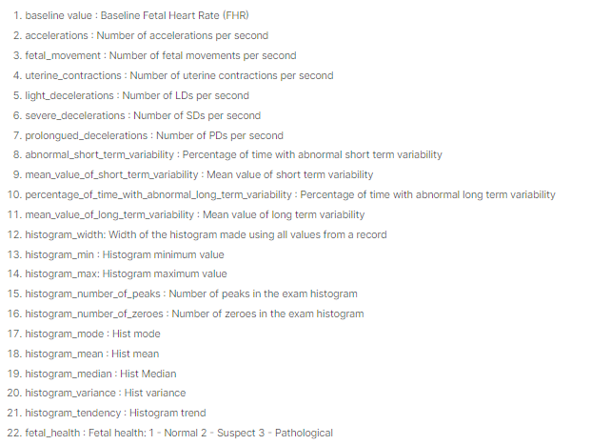
Data Dictionary
Features:
Target:

Slide 6
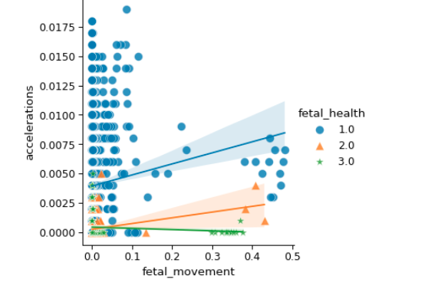
Data Visualization ( EDA)
Accelerations —
These are short periods of elevation of the fetal heart are above the baseline rate by > 15 bpm for > 15 s. Accelerations are frequently associated with fetal movement and are thus indicative of a functioning somatic nervous system and are reassuring.

Slide 7
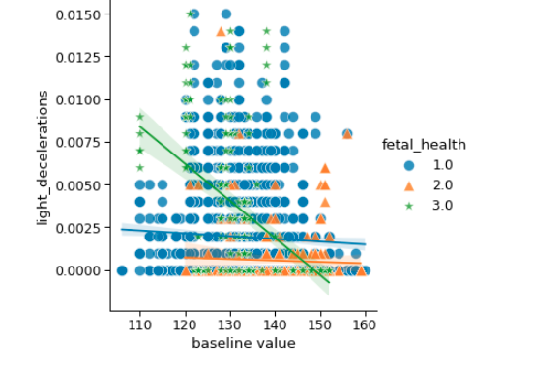
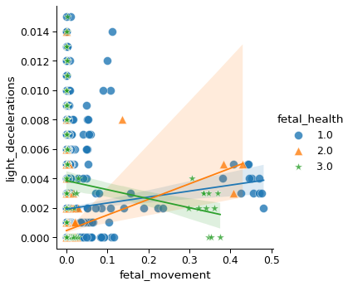
EDA cont.
Deceleration— There are numerous different types of decelerations observed during labour, and not all are pathological, however decelerations occurring in the antenatal period in the absence of precipitating uterine contractions are nearly always a sign of fetal compromise.

Slide 8
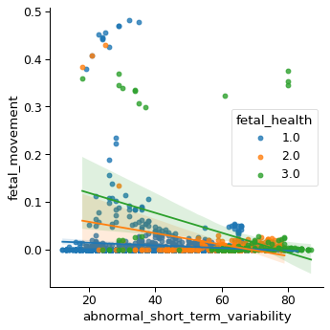
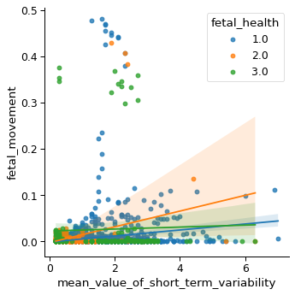
EDA cont.
Short term variation —Short term variation (STV) examines the variability of the fetal heart rate from beat to beat, and cannot be interpreted by observer visual analysis. This parameter is only available with computerized CTG.
A reduced STV (< 3.0 msec) has been reported to correlate with stillbirth and severe fetal acidaemia

Slide 9
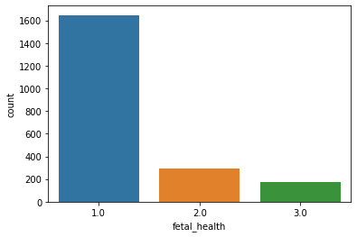
Fetal Health Distribution
Distribution of outcomes — This is definitely a challenge in the machine learning modeling and will be addressed during the coding.

Slide 10
Classification Models - Accuracy and F1 Score Snapshot

Slide 11
Different Boosting models for our Outcome distribution challenge-

Slide 12
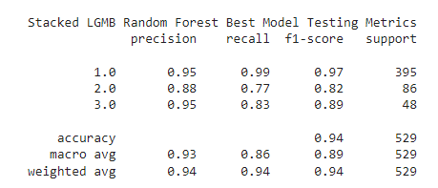
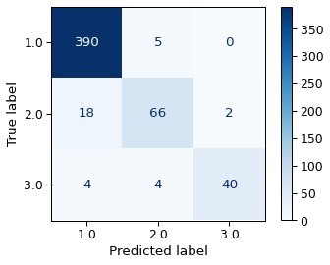
Proposed Model – A Stacked Hyper tuned Random forest with a LightGBM boost

Slide 13

Recommendations
This tool is able to predict pathologic out comes with a relatively high percentage of accuracy.
Further Thoughts & Recommendation :-
Consulting with further subject matter experts to remove the suspected data set, as this is a grey area and needing further investigation even by expert ObGyns.
Additional features such as estimated fetal weight as that impacts baseline FHR.
Clustering Histogram features (feature engineering).
Additional unsupervised machine learning models can be explored.

